Slide 1

Vehicle stability control using Sideslip Control
Vehicle Dynamics & Control - R047017
By Group 5:
Neeraja Bhide (5495601)
Pavan Prasad H.G. (5508053)
Paul Kartoidjojo (4480961)
Anand Srikrishna (5306485)

Slide 2
Table of contents
Motivation
Problem Statement
Control Strategies
Vehicle Validation Model
Simulation & Results
Conclusion
Future Work

Slide 3
Motivation

Slide 4
Motivation:
Vehicle sideslip angle is a major indicator of dynamics stability for ground vehicles. [1]
Sideslip angle can provide important information for direction stability control systems. [2]
It is immeasurable with commercially-available sensors.
[1] - Jizheng Liu et al. Sideslip Angle Estimation of Ground Vehicles: A Comparative Study
[2] - Federico Cheli et al. A methodology for vehicle sideslip angle identification: comparison with experimental data

Slide 5
Problem Statement

Slide 6
Problem Statement
“ Vehicle stability control from body Sideslip Control using Direct Yaw Moment Control”

Slide 7
Control Strategies

Slide 8
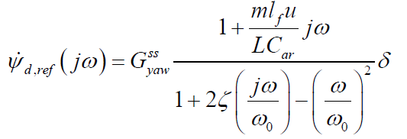
Reference Generator
Reference yaw rate (r_{d,ref}) is generated from the steering wheel angle δ input using the bicycle model second-order transfer function

Slide 9
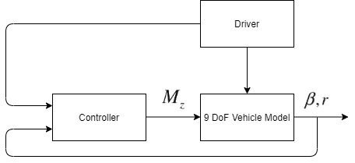
Direct Yaw moment Control
Error Yaw rate is fed into the controller.
LQR controller is designed considering the control input dM_{Z}
M_{z} = K_{lqr} (u)(r_{d,ref} − r)

Slide 10
Control Strategies
Direct Yaw Moment Control (DYC) with PD Control of Sideslip angle
Direct Yaw Moment Control (DYC) with reference correction
Direct Yaw Moment Control (DYC) with the saturation of yaw rate
Notes:
\

Slide 11
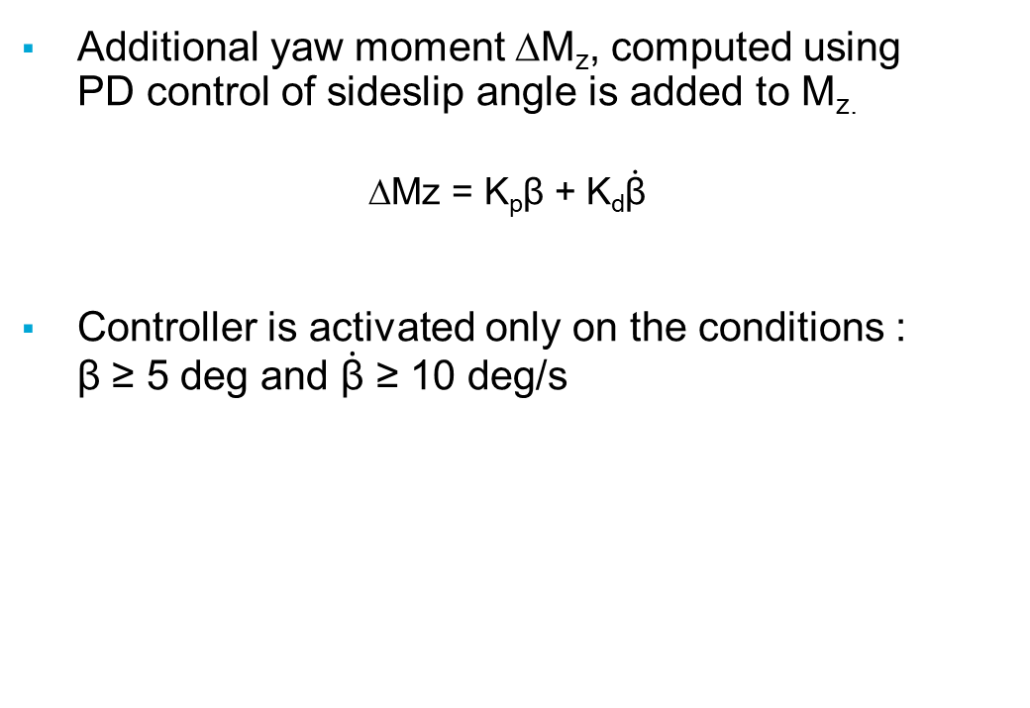
PD Control of Sideslip angle
Additional yaw moment ∆M_{z}, computed using PD control of sideslip angle is added to M_{z.}
$$\text{∆}\text{Mz}\text{ = }\text{Kp}\text{β}\text{ + }\text{K}\text{d}\dot{\text{β}}$$
Controller is activated only on the conditions : β ≥ 5 deg and $\dot{\text{β}}$ ≥ 10 deg/s

Slide 12

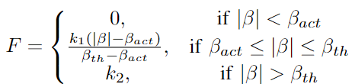
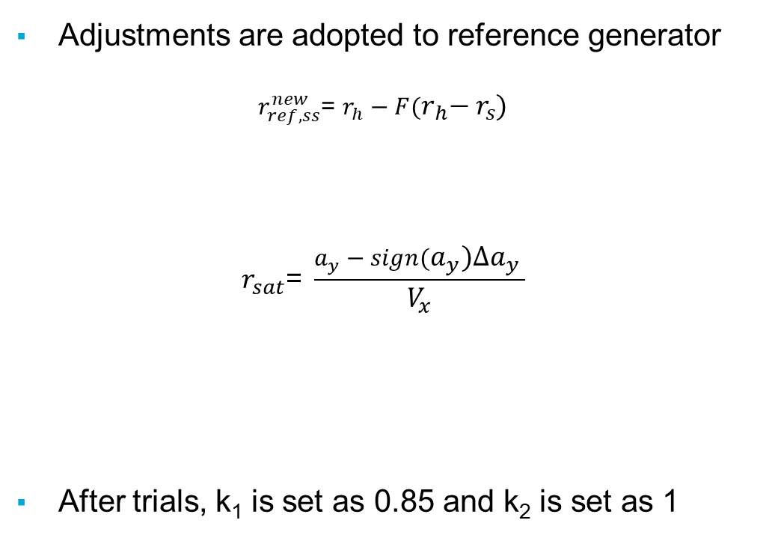
With reference correction
Adjustments are adopted to reference generator
$$r_{ref,ss}^{new}\text{= }r_{h}−F(r_{h}{− r}_{s})$$
$$r_{sat}\text{= }\frac{a_{y}−sign(a_{y}){∆a}_{y} }{V_{x}}$$
After trials, k₁ is set as 0.85 and k₂ is set as 1

Slide 13




With yaw rate saturation
Limitation is introduced on the maximum lateral acceleration and maximum sideslip angle
Reference sideslip angle is assigned as
The maximum yaw rate is thus obtained as
Steady state yaw rate is assigned with

Slide 14
Vehicle Validation Model

Slide 15
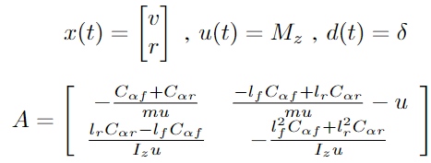


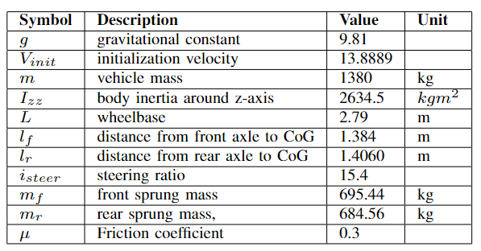
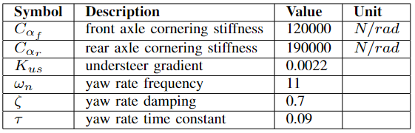
Vehicle validation model
Linear Bicycle model :
Notes:
\

Slide 16
Simulation & Results

Slide 17
Simulation test maneuvre
Sine with Dwell test (ISO 19365:2016) is performed.
Sine with Dwell maneuver is the worst-case scenario test used to test vehicle stability.
Reference longitudinal velocity is 100 kmph and friction coefficient is 0.3.
Low friction coefficient is considered to simulate higher sideslip angle evolution.
Notes:
\

Slide 18
Conclusions

Slide 19
Conclusions
Notes:
\

Slide 20
Future work

Slide 21
Future Work
Notes:
\

Slide 22
Thank you for your attention
Neeraja Bhide (5495601)
Pavan Prasad H.G. (5508053)
Paul Kartoidjojo (4480961)
Anand Srikrishna (5306485)

